Slide 1
ASSIGNMENT 1
BASIC OHMMETRE AND CAPACITANCE MEASURMENT
Name-Priyanshu Mehta
Roll Number-240808

Slide 2
OBJECTIVE
. In this assignment we are designing a simulated measurement module
that performs a basic resistance and capacitance measurement on Tinkercad using Arduino Uno.
. Understanding theoretical values and comparing them with tinker cad results to achieve a conclusion of error and noises sources present in the circuit
. The whole concept of simple ohmmeter and capacitance measurement is basic circuit laws including voltage divider analysis and calculating time upto when voltage across capacitor reaches a threshold.

Slide 3
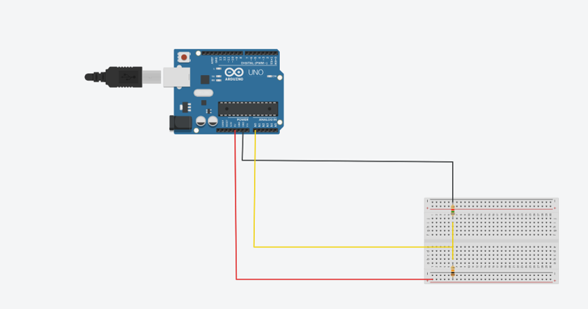
TASK A -VOLTAGE DIVIDER ANALYSIS FOR ESTIMATING VOLTAGE

Slide 4
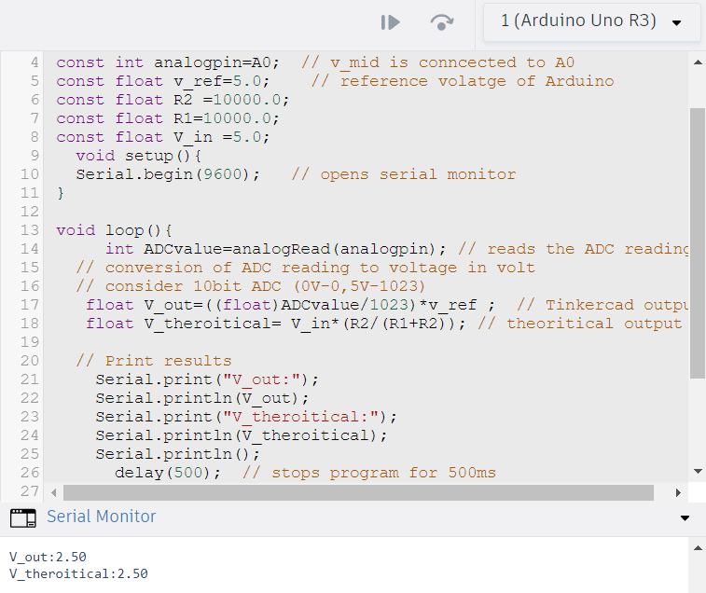
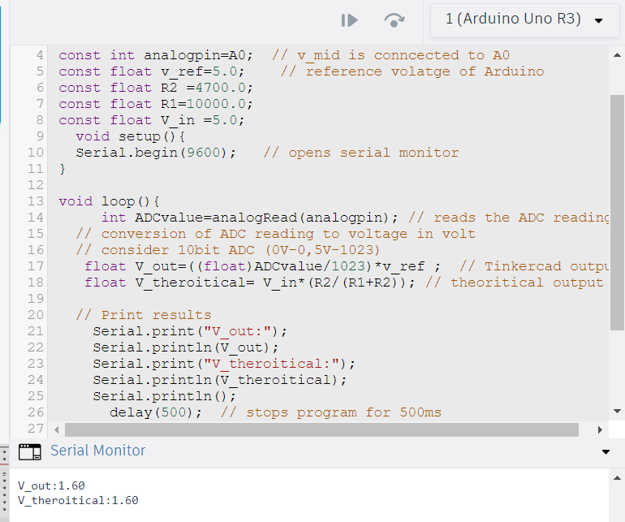
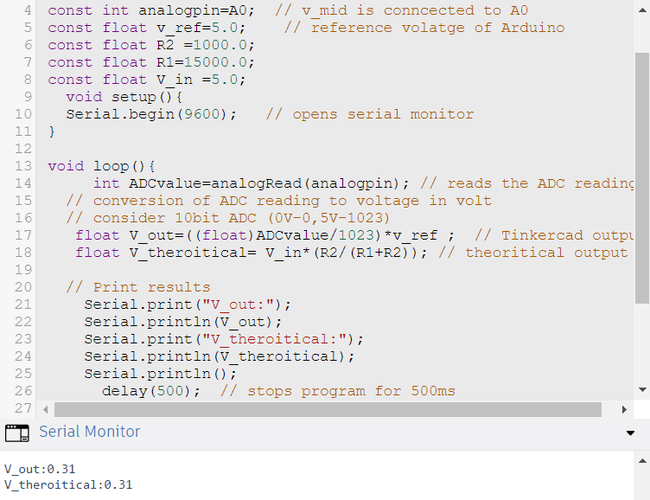
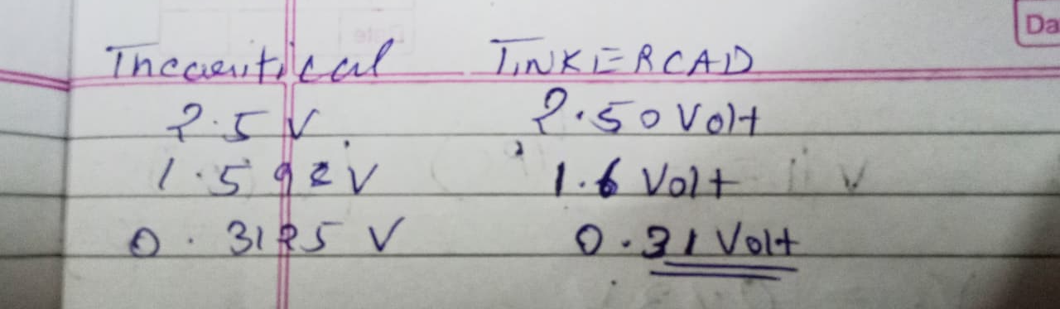
PAIR(10Kohm-10kohm) PAIR(4.7Kohm-10kohm) PAIR(1Kohm-15kohm)

Slide 5
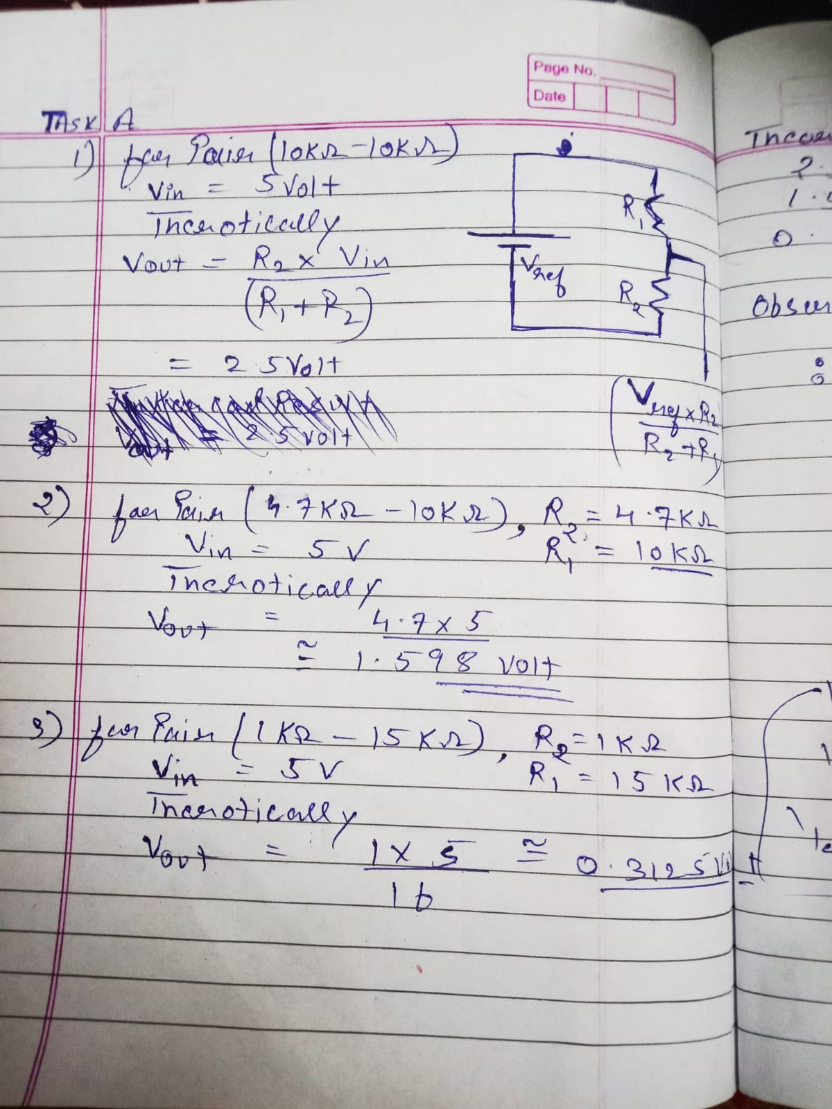
. analogRead() convert and read ADC reading that lies between 0-1023 depending on voltage across R2.
. Even for a fixed DC constant voltage , ADC reading may vary between two or more values because of ADC quantization error
. However we are getting approx same values of voltages from serial monitor as expected as tinkercad treat resistances as ideal and deals with stable ADC readings .

Slide 6
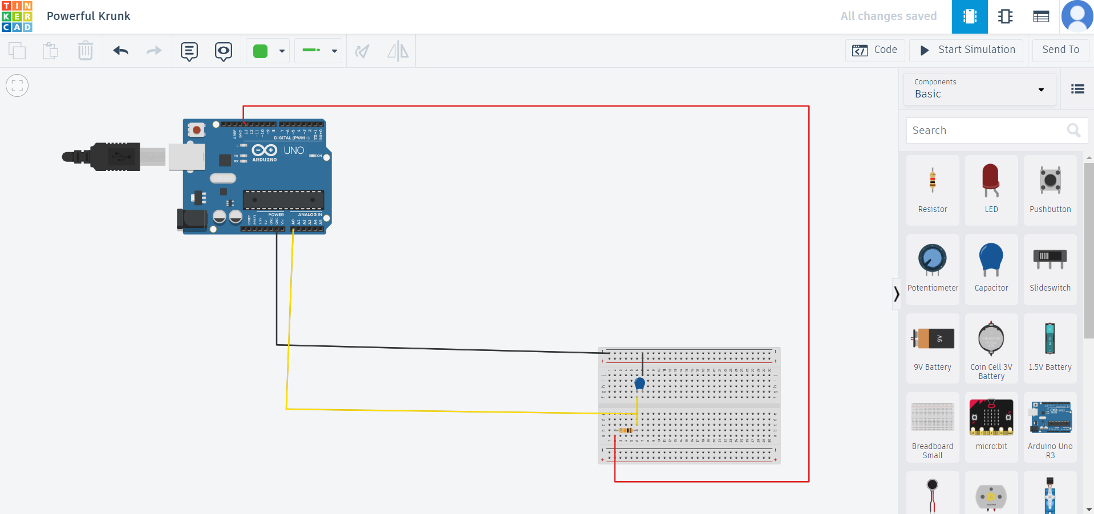
TASK B – CAPACITANCE MEASUREMENT FROM RC TIME CONSTANT

Slide 7
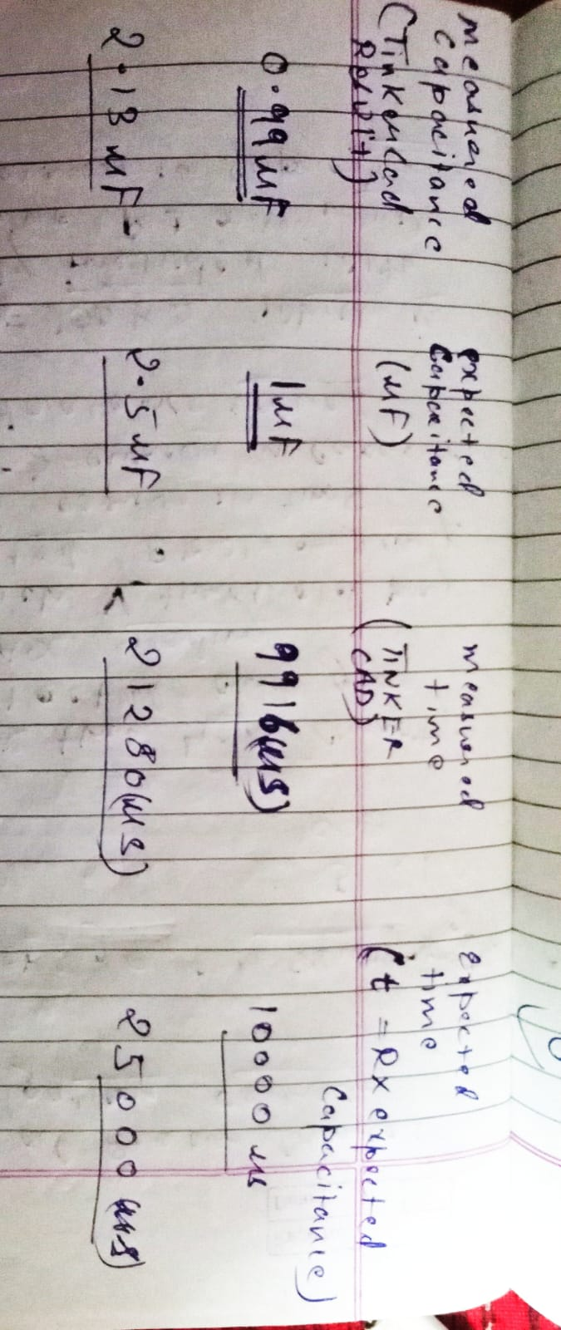
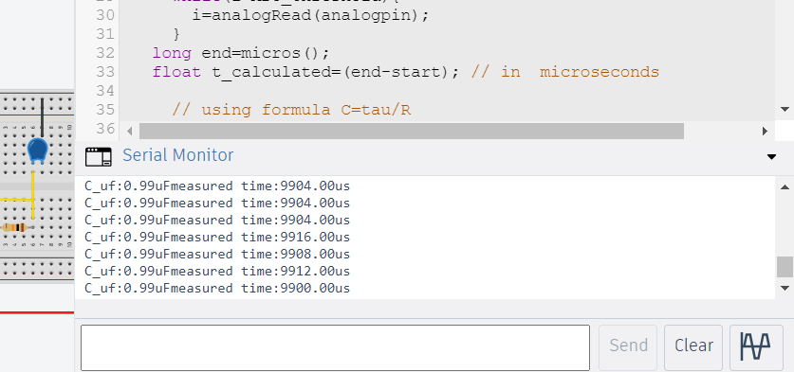
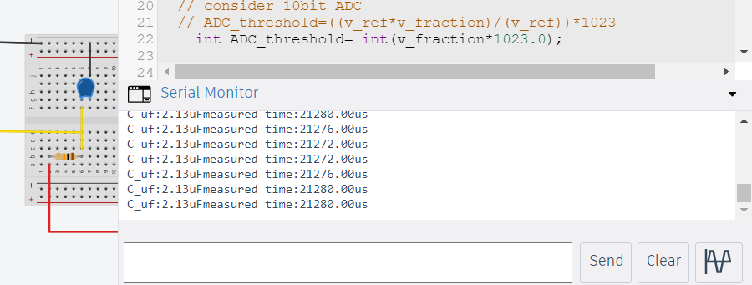
For Capacitance =1uf For Capacitance=2.5uf

Slide 8
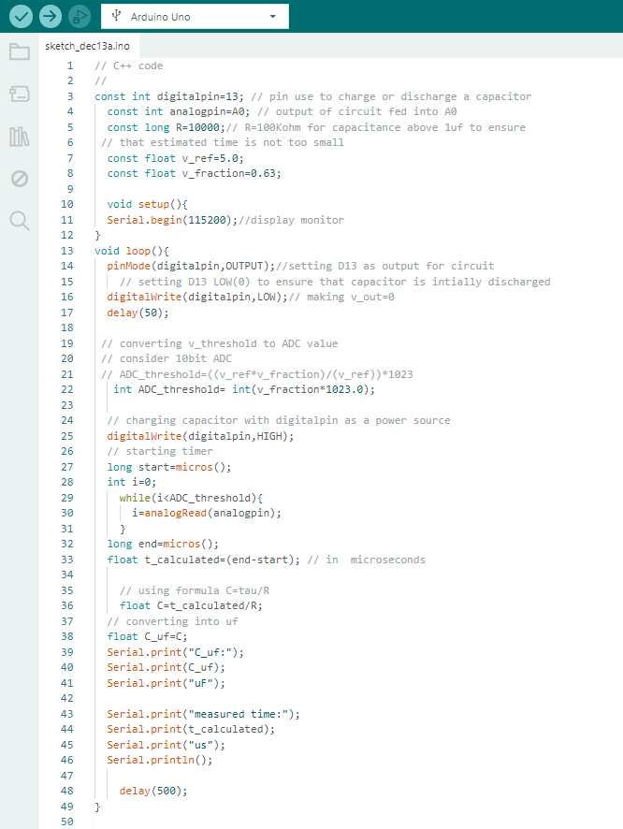
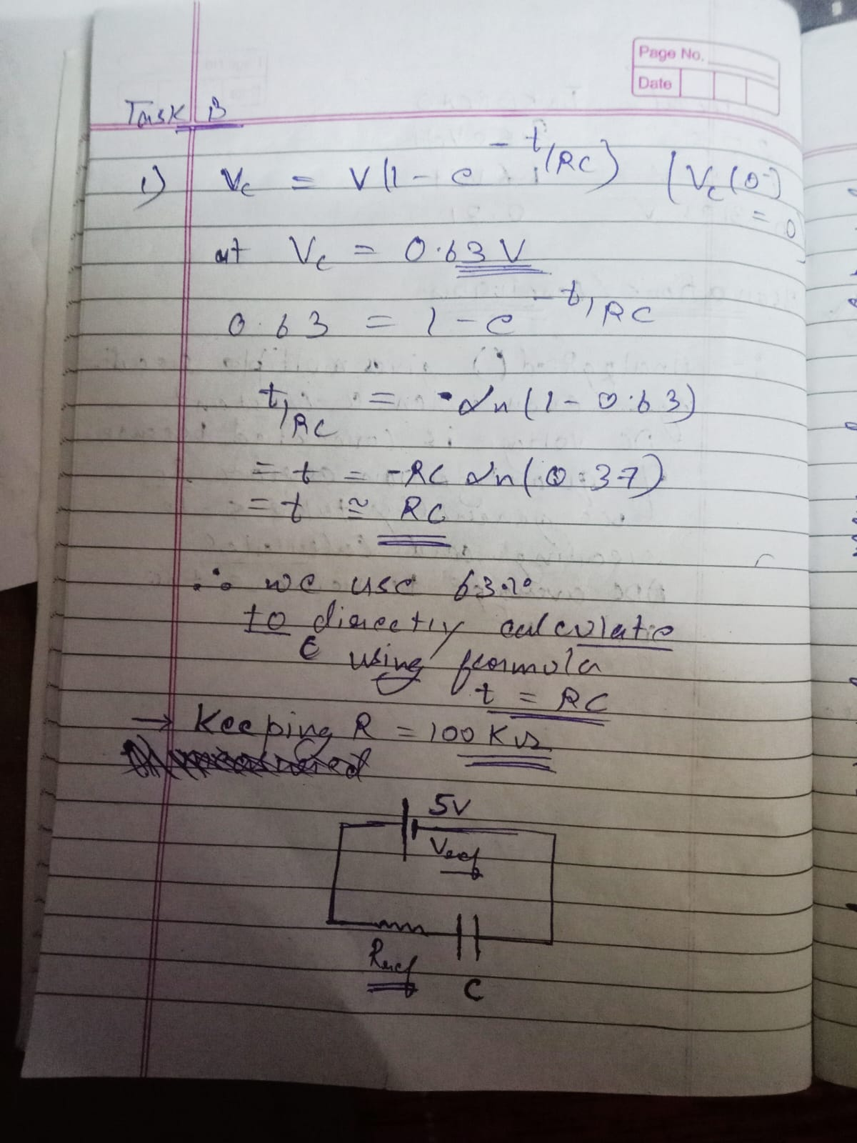
hhhhhhhhhhhhhhhhhhhhhhhhh

Slide 9
Some Potential sources
1) ADC Quantization error : for ADC with 0-0V and 1023-5V , difference between two consecutive digital numbers =(5/1023)*1000=4.88mv so voltage change less than 4.88 cannot be detected and give previous ADC reading due to which threshold voltage may be detected slowly or early which can give error in time implies error in capacitance
2) Resistance tolerance values:
Here we used R=100kohm which is basically included with tolerance values (R+-x%) which may give error in capacitance
3) Capacitance takes some time to discharge. If it is initially not discharged completely then time taken to reach threshold voltage may be different from expected one and due to which we can get error in capacitance.

Slide 10
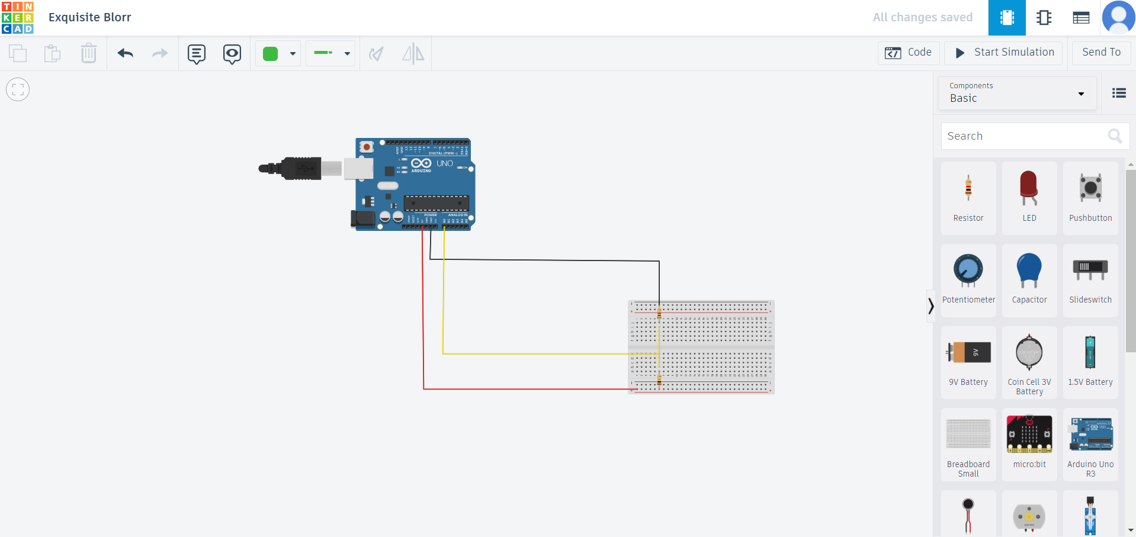
TASK C –BASIC OHMETRE USING VOLTAGE DIVIDOR METHOD

Slide 11
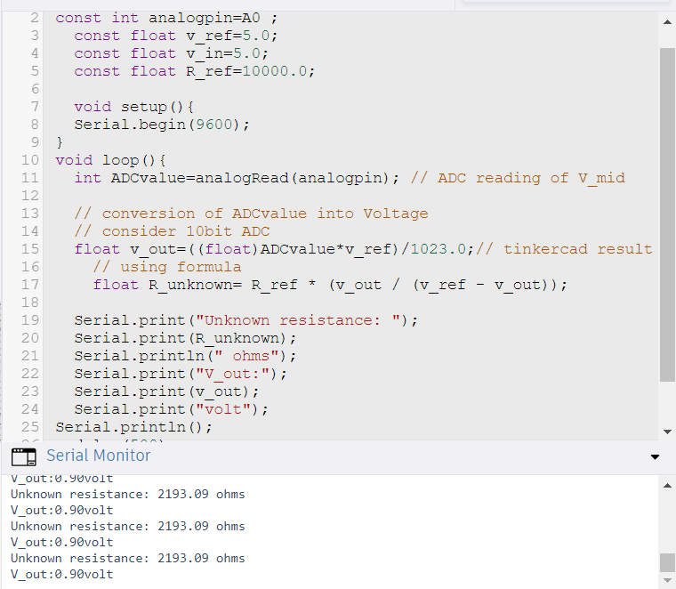
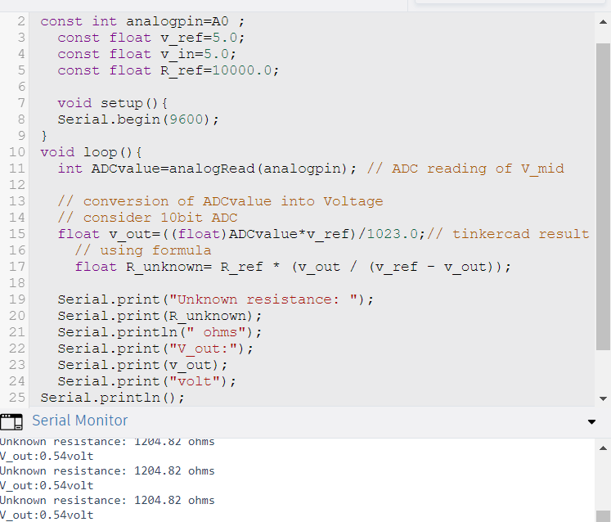
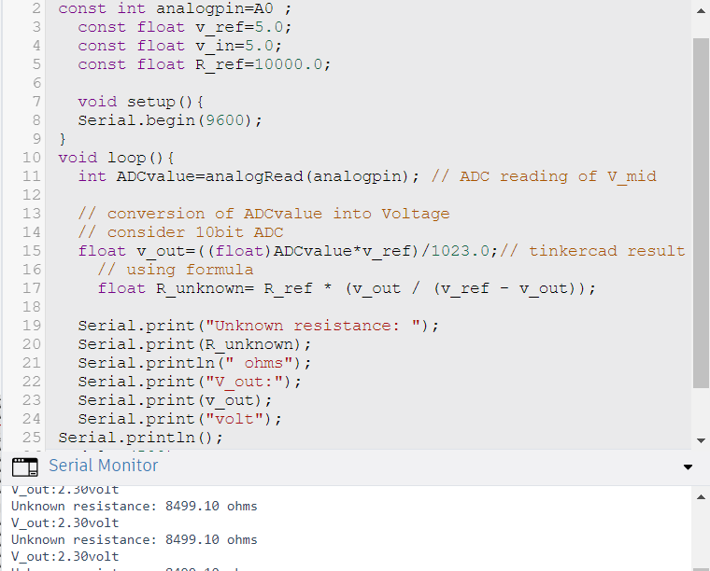
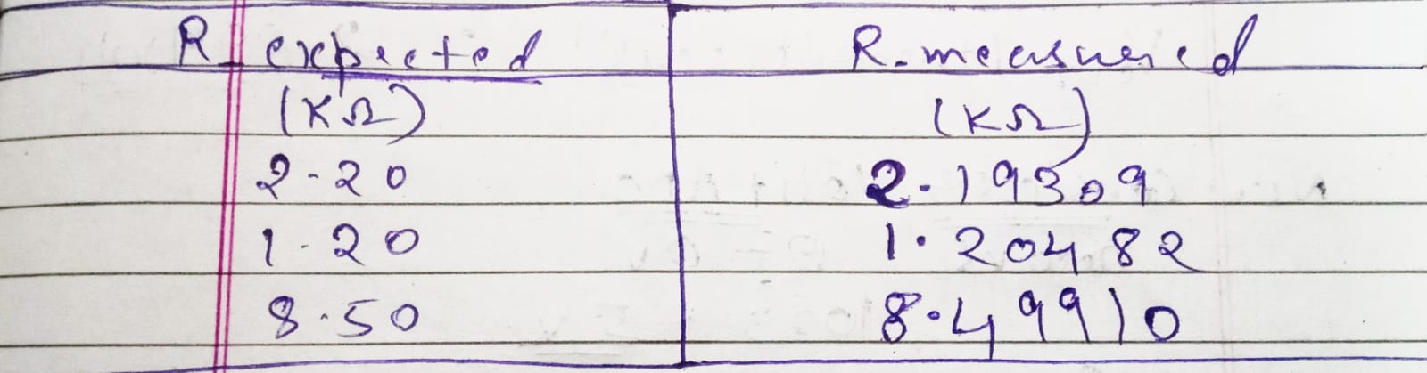
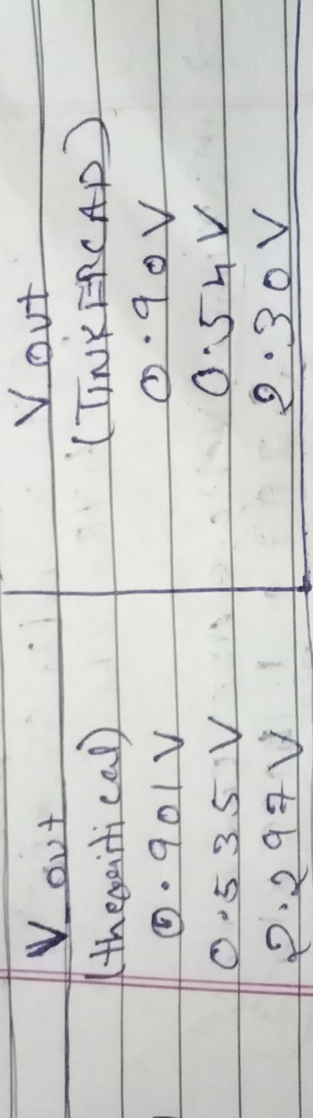
For Resistance=2.2Kohm For Resistance=1.2Kohm For Resistance=8.5Kohm

Slide 12
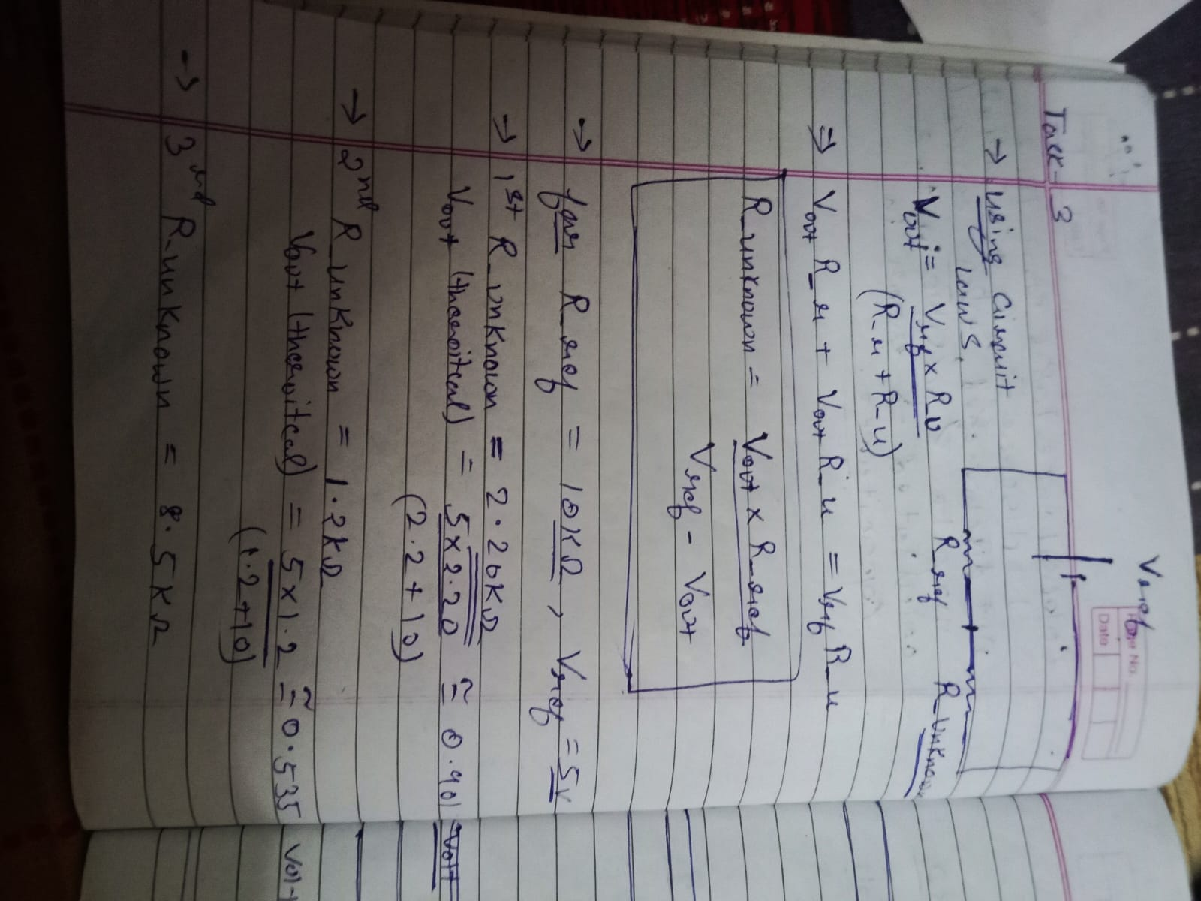
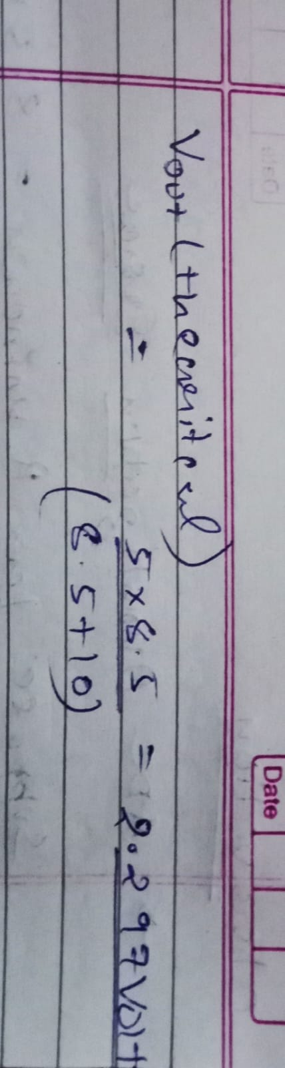
Theoretical Calculations

Slide 13
. Suppose for unknown resistor=8.5Kohm
. We find output voltage 2.297volt theoretically
. Now consider 10 bit ADC (0-0Volt, 1023-5volt),
. We know Each step has a size of (5/1023)*1000=4.88mv
. So the maximum ADC error = +- ½(4.88mv)
. Let convert output voltage to ADC value that is
. 2.297=n(4.88/1000) which gives n approx 478.54
.So maximum Voltage ADC can read = 2.297+(1/2)*(4.88/1000)=2.29944volt
.Similarly minimum voltage ADC can read=2.297-(1/2)*(4.88/1000)=2.29454volt
.So output voltage vary from 2.29454 to 2.29944 due to which ADC reading varies as 478,479,478..
.This is called ADC quantization error.

